Slide 1

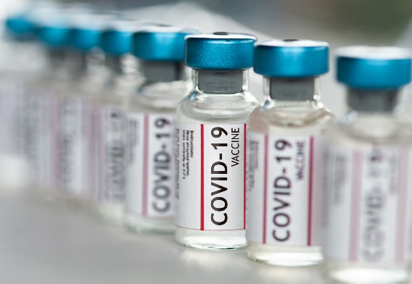
Covid-19 Vaccines - Is there a best vaccine?
Supraja Rapuru

Slide 2
Agenda
Project Summary
Ethics Statement
Factors Evaluated
Vaccine Categories
Vaccine Components
Vaccine Efficacy
Vaccine Adverse Effects
Conclusion
Appendix

Slide 3
Project Summary
Severe acute respiratory syndrome coronavirus 2 (SARS-CoV-2) infection and the resulting coronavirus disease 2019 (Covid-19) have afflicted tens of millions of people in a worldwide pandemic. Safe and effective vaccines are needed urgently.
The project aims to convey the analysis of different ongoing vaccination programs with in United States of America by using all publications, reports, and news articles and review all available data to find how effective vaccines are at achieving multiple outcomes.
The objectives for the following project to prove there is no best vaccine. All the vaccines are effective, particularly at preventing serious disease. Because trials were conducted differently at different times, effectiveness figures cannot be directly compared.

Slide 4
Ethics Statement
In this study i have extracted and recorded the publicly available database literature on coronavirus, SARS-CoV-2, COVID-19 vaccine, Pfizer/BioNTech and Moderna vaccines; hence, Ethical approval was not required.

Slide 5
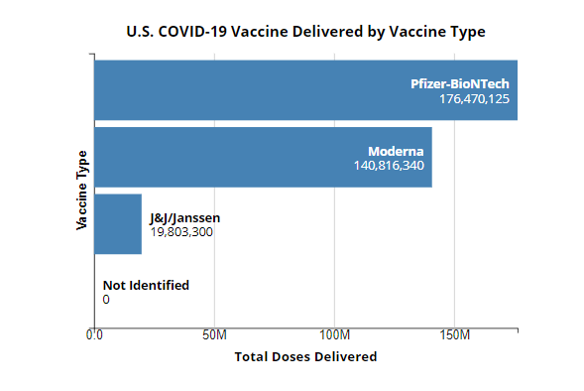
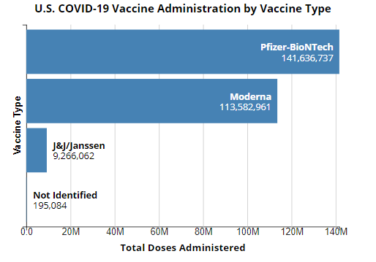
Vaccines Categories
Inferences: As per the charts above, Pfizer vaccines numbers are high comparatively to Moderna and Janaseen. As per the second chart Pfizer has got more doses delivered, that explains why we see pfizer is widely administered vaccine in USA. Pfizer/BioNTech has gained more popularity due to its better manufacturing capabilities abilities, so they are making more vaccines and the same is procured and distributed by US Federal government to all its jurisdictions.
Pfizer is most allocated and distributed vaccine by federal government

Slide 6
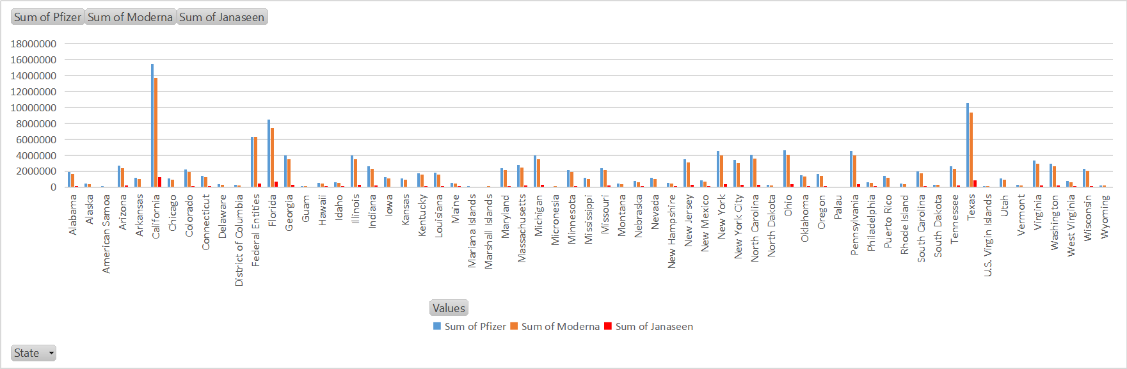
US Covid-19 Vaccine Distribution by State/Jurisdiction
Vaccine Distribution by types and by States
Vaccine Distribution Start Dates
Data Source downloaded: CDC.Data.gov
Inferences: As per FDA briefings, it is approved Pfizer-BioNTech on Dec 10,2020 and Moderna on Dec 17,2020 for emergency use. Hence it is evident that the testing done possibly on different strains circulating in those different populations of people.
Pfizer and Moderna are distributed to states by federal government hence you see the # of people vaccinated with Pfizer and Moderna are more. Pfizer distribution started on 12/14/2020, Moderna on 12/21/2020 where as Janseen is March 2021. Also news about blood clotting events for Janaseen has kept the distribution on hold. Between Pfizer and Moderna, Pfizer has more numbers and make it popular.

Slide 7
Vaccines Components
The vaccines developed by Pfizer-BioNTech and Moderna take advantage of messenger RNA (mRNA), which instructs cells to produce a protein on the surface of the virus. The immune system recognizes those vaccine-triggered spike proteins as invaders and creates antibodies to block future attacks of the virus that causes COVID-19.
Moderna’s vaccine uses 100 micrograms of RNA per dose, while Pfizer-BioNTech’s shot uses only 30 micrograms making it easier to produce and less expensive. That should enable Pfizer-BioNTech to increase production of their vaccine more quickly than Moderna which is evident pfizer vaccinated population is more than others in USA.
Pfizer uses less RNA per dose hence production rate is high which proves
why # vaccinated people with Pfizer are more.

Slide 8
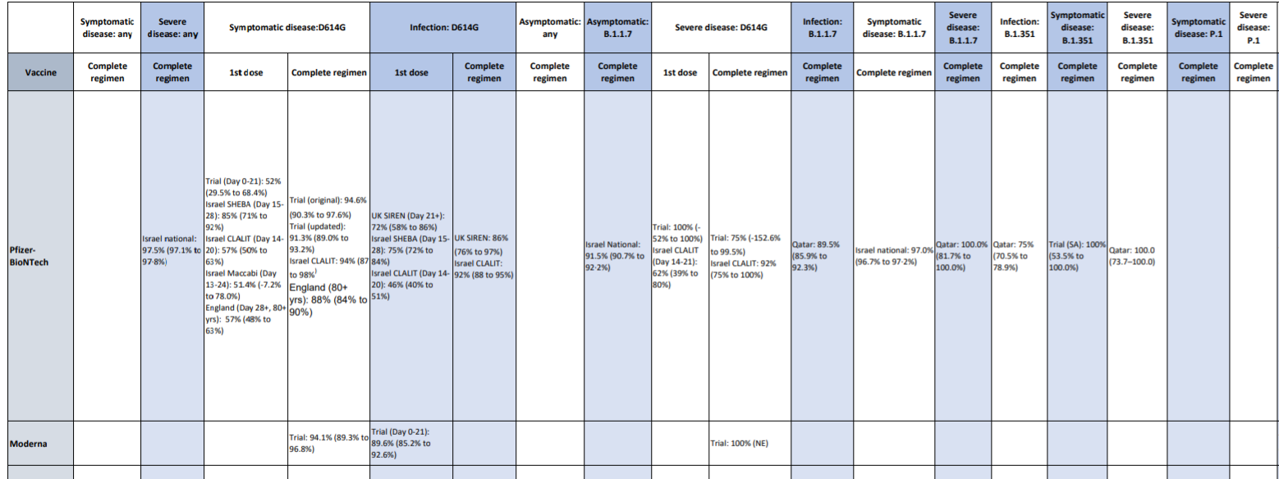
COVID-19 Vaccine Efficacy - Data available today consist of clinical trials and several quasi-observational studies
Based on the published details, it is evident that Pfizer has more studies done on multiple variants and overall efficacy rate of 95% which probably one of the key factor to gain peoples confidence thus reducing hesitancy rate among people of United states of America.

Slide 9
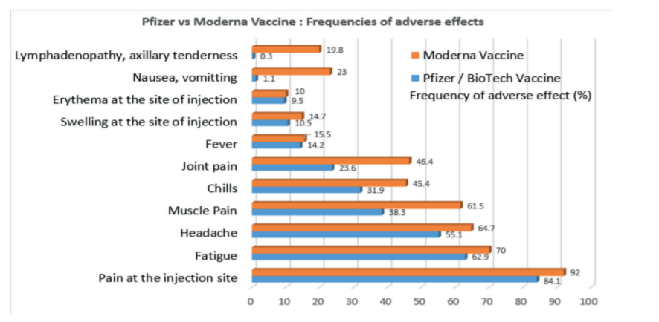
COVID-19 Vaccine common side effects
The percentage of these adverse effects is reported to be lower with the Pfizer/BioNTech vaccine
than with the Moderna vaccine, however the Moderna vaccine compared to the Pfizer
vaccine is easier to transport and store because it is less temperature sensitive.
It must be noted that because clinical trials are conducted under widely varying conditions, adverse reaction rates observed in the clinical trials of a vaccine cannot be directly compared with rates in the clinical trials of another vaccine and may not reflect the rates observed in practice.

Slide 10
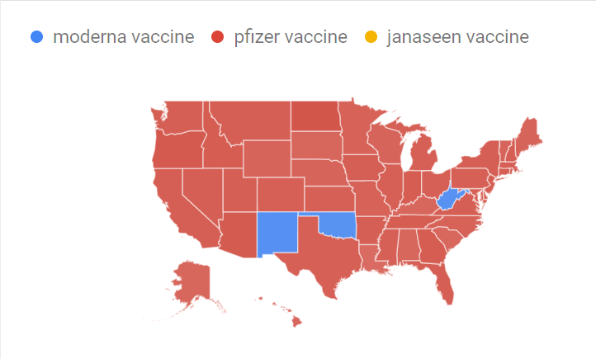
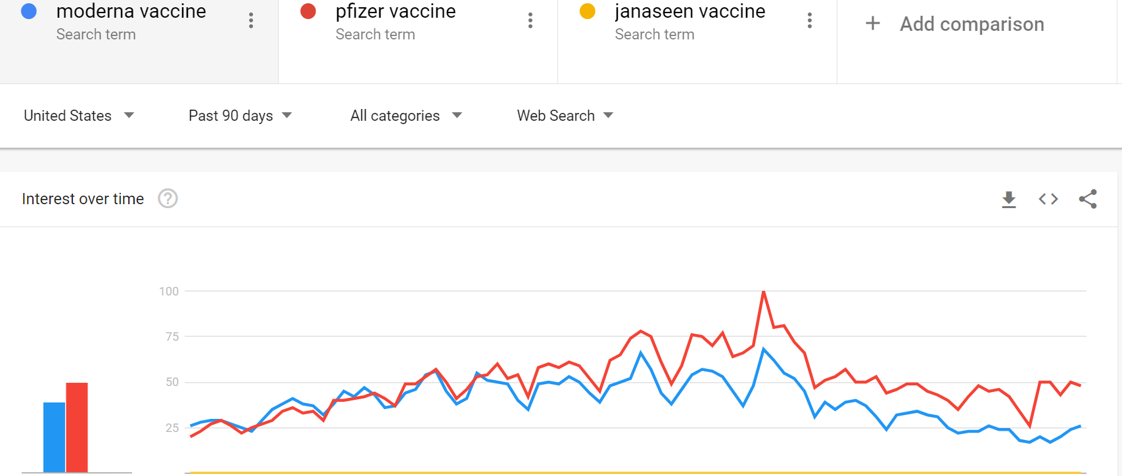
COVID-19 Vaccine - Interest Over time
Based on the google trends data, pfizer stood out as most searched over others and searched in most of the states in USA.

Slide 11
COVID-19 Vaccine - Recent study by CDC
The recent study done by CDC among health health care personnel, first responders, and other essential workers aim to look at the effectiveness of Pfizer-BioNTech and Moderna mRNA vaccines in preventing SARS-CoV-2 infections among 3,950 study participants in six states over a 13-week period from December 14, 2020 to March 13, 2021.
Results showed that following the second dose of vaccine (the recommended number of doses), risk of infection was reduced by 90 percent two or more weeks after vaccination. Following a single dose of either vaccine, the participants’ risk of infection with SARS-CoV-2 was reduced by 80 percent two or more weeks after vaccination.
Content source: Centers for Disease Control and Prevention

Slide 12
Conclusion
These vaccines can protect recipients from a SARS-CoV- 2 infection by formation of antibodies and provide immunity against a SARS-CoV-2 infection. Though based on # of vaccines administered in USA, Clinical trails observations, Efficacy rate, adverse effects, google trends - it is natural one to believe Pfizer is more effective but scientifically it is unfair to compare as they were tested in different points in time. They were tested in different populations of people when there were different strains circulating in those different populations of people.
Both vaccines can cause various adverse effects, but these reactions are reported to be less frequent in the Pfizer/BioNTech vaccine compared to the Moderna COVID-19 vaccine; however, the Moderna vaccine compared to the Pfizer vaccine is easier to transport and store because it is less temperature sensitive. Also please note the efficacy rates, observations studies from trails done not the actual people vaccinated as of today. By looking at the numbers, i conclude it is difficult to decide which one is better.

Slide 13
Appendix
References:
www.nejm.org/doi/full/10.1056/NEJMoa2034577
www.thelancet.com/journals/lancet/article/PIIS0140‐6736(21)00448‐7/fulltext
www.nejm.org/doi/full/10.1056/NEJMoa2101765
papers.ssrn.com/sol3/papers.cfm?abstract_id=3790399
www.medrxiv.org/content/10.1101/2021.01.27.21250612v1
assets.publishing.service.gov.uk/government/uploads/system/uploads/attachment_data/file/963532/CO
VID‐19_vaccine_effectiveness_surveillance_report_February_2021_FINAL.pdf
https://www.pfizer.com/news/press‐release/press‐release‐detail/pfizer‐and‐biontech‐confirm‐high‐
efficacy‐and‐no‐serious
https://www.nejm.org/doi/full/10.1056/NEJMc2104974
https://www.thelancet.com/journals/lancet/article/PIIS0140‐6736(21)00947‐8/fulltext

